Slide 1


CGB1221 DATABASE MANAGEMENT SYSTEMS
PROJECT REVIEW
Department of Computer Science and Engineering
Academic Year: 2025 – 2026 (Odd Semester)
SANTHOSH SHARMA M [CSC23136]
SARAVANAPRIYAN M[CSC23138]
SEENIVASAN S [CSC23139]
SIBI S [CSC23149]
Guided By : Mrs.KALPANA, AP/CSE

Slide 2
TITLE OF PROJECT
HOSTEL MANAGEMENT
SYSTEM

Slide 3
ABSTRACT
The Hostel Management System is a software application designed to simplify and automate the process of managing hostel operations. Traditional hostel management involves extensive manual record-keeping, which is time-consuming, error-prone, and inefficient. This system provides a centralized digital platform to handle key activities such as student registration, room allocation, fee management, attendance tracking, and complaint handling. The system ensures data accuracy, enhances transparency, and provides quick access to relevant information for both administrators and students. Developed using [insert technologies used, e.g., PHP, MySQL, and HTML/CSS], the application features a user-friendly interface and secure database management. By reducing administrative workload and improving operational efficiency, the Hostel Management System contributes to better resource utilization and an improved hostel experience.

Slide 4
INTRODUCTION
The Hostel Management System is an integrated software solution developed to streamline and automate the day-to-day administrative operations of a hostel. In many educational institutions and organizations, hostels play a vital role in providing accommodation to students or employees. However, managing hostel activities manually often leads to challenges such as data redundancy, inefficiency, difficulty in tracking records, and human errors.

Slide 5
Existing System
Manual Record-Keeping:
Hostel data such as student details, room allocations, and fee records are maintained manually in registers or spreadsheets
Time-Consuming Processes:
Administrative tasks like room assignment, fee collection, and report generation require significant time and effort.
High Chance of Errors:
Manual entry and record management often lead to human errors, data duplication, and loss of important information.
Difficulty in Data Retrieval:
Searching and updating student or room information from paper records or files is cumbersome and inefficient.

Slide 6
Proposed System
Automation of Processes:
The proposed system automates key hostel management activities such as student registration, room allocation, and fee collection, reducing manual workload.
Centralized Database:
All hostel-related data is stored in a centralized and secure database, allowing easy access, updating, and management of records.
User-Friendly Interface:
The system provides a simple and interactive interface for both administrators and students to perform their tasks efficiently
Efficient Room Management:
Administrators can easily assign rooms, view occupancy status, and manage availability in real time.

Slide 7
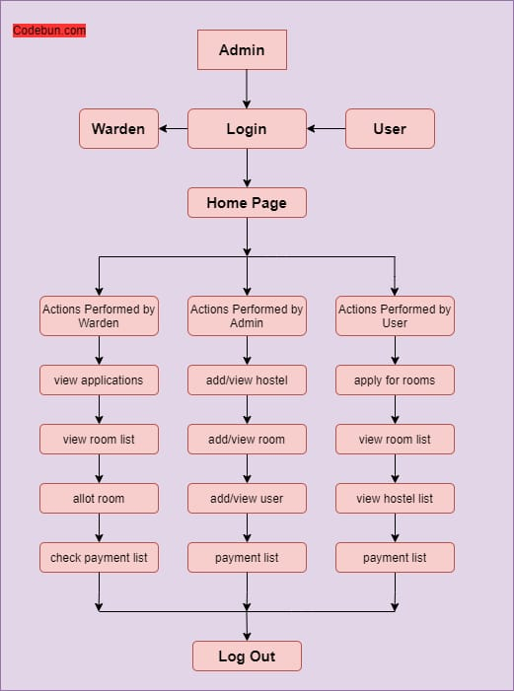
PROPOSED ARCHITECTURE

Slide 8
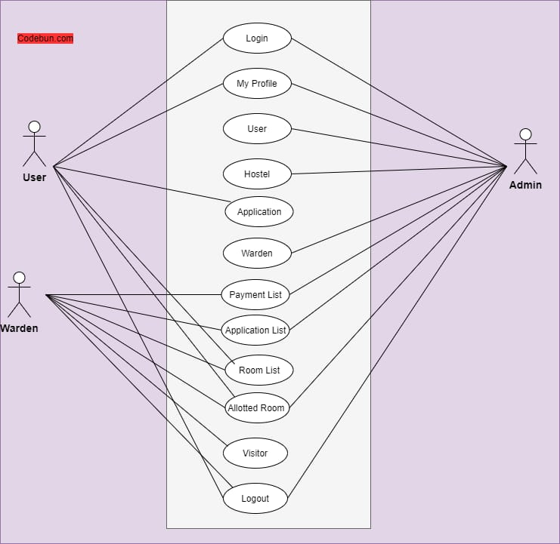
Use case diagram

Slide 9
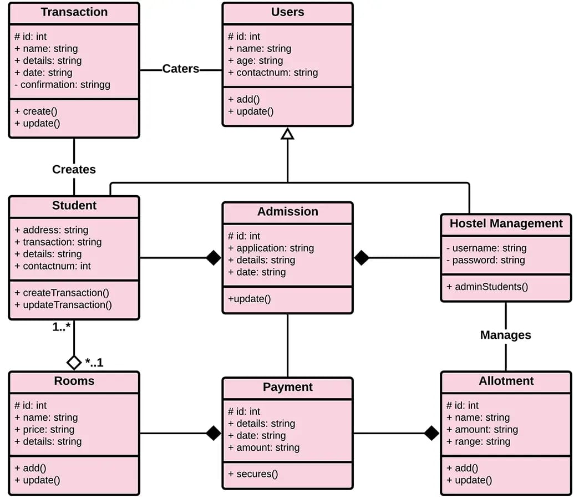
Class Diagram

Slide 10
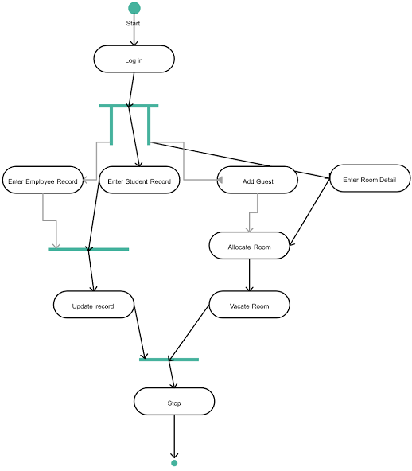
Package Diagram

Slide 11
PROPOSED ARCHITECTURE
– DESCRIPTION
The diagram shows the Hostel Management System workflow, where Admin, Warden, and User log in through a common homepage and perform different actions based on their roles.
Admin manages hostels, rooms, and users; Warden handles applications, room allotment, and payments; while Users (students) apply for rooms, view details, and check payment status before logging out.

Slide 12
LIST OF MODULES
Login and Authentication Module
Student Management Module
Room Allocation Module
Fee Management Module
Attendance Management Module
Admin Control Module

Slide 13
MODULE DESCRIPTION
1. Login and Authentication Module
Provides secure login for Admin, Warden, and Students using unique credentials.
Ensures role-based access and prevents unauthorized system entry.
2. Student Management Module
Maintains complete student records including personal and academic details.
Allows adding, updating, viewing, and deleting student information easily.

Slide 14
MODULE DESCRIPTION
3.Room Allocation Module
Manages room availability, allocation, and occupancy status.
Updates room details automatically when students check in or vacate.
4. Fee Management Module
Handles fee payment records, pending dues, and receipt generation.
Generates financial summaries and reports for easy monitoring.

Slide 15
MODULE DESCRIPTION
5. Attendance Management Module
Tracks student attendance and maintains daily or monthly reports.
Helps wardens monitor student presence and detect irregularities.
6. Admin Control Module
Provides full control to the admin for managing users, rooms, and data.
Allows report generation, system configuration, and data backup.

Slide 16
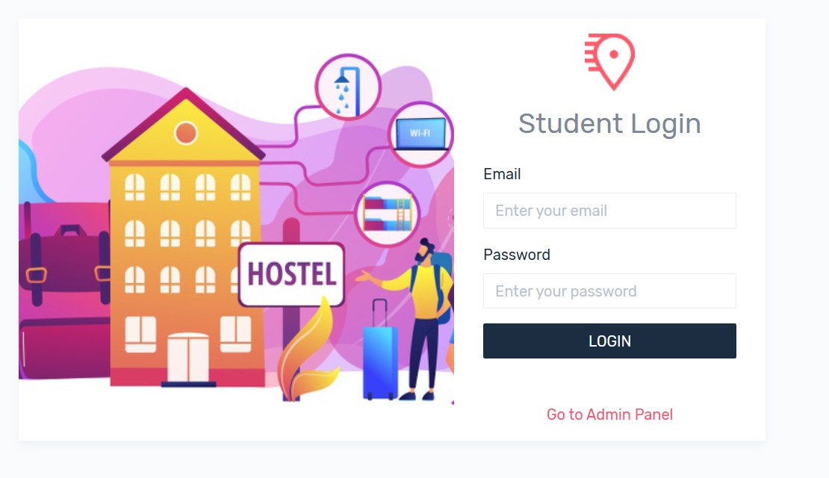
RESULTS AND DISCUSSION
LOGIN

Slide 17
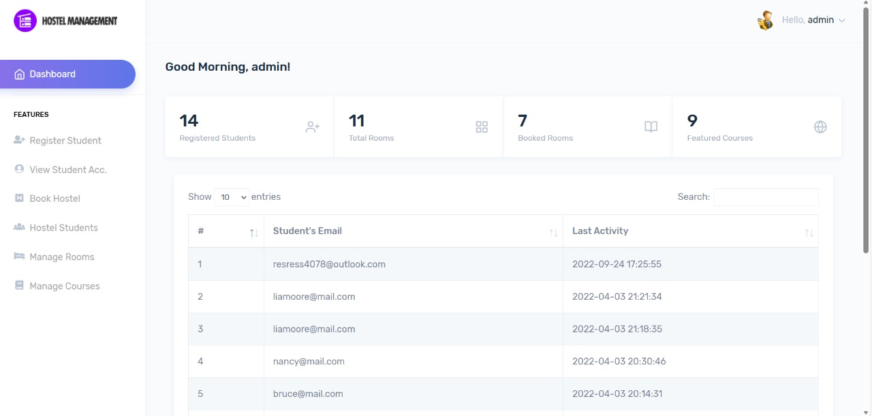
RESULTS AND DISCUSSION
DASHBOARD

Slide 18
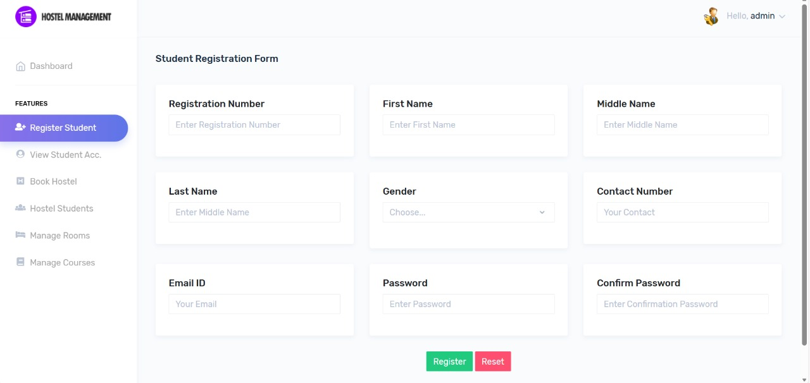
RESULTS AND DISCUSSION

Slide 19
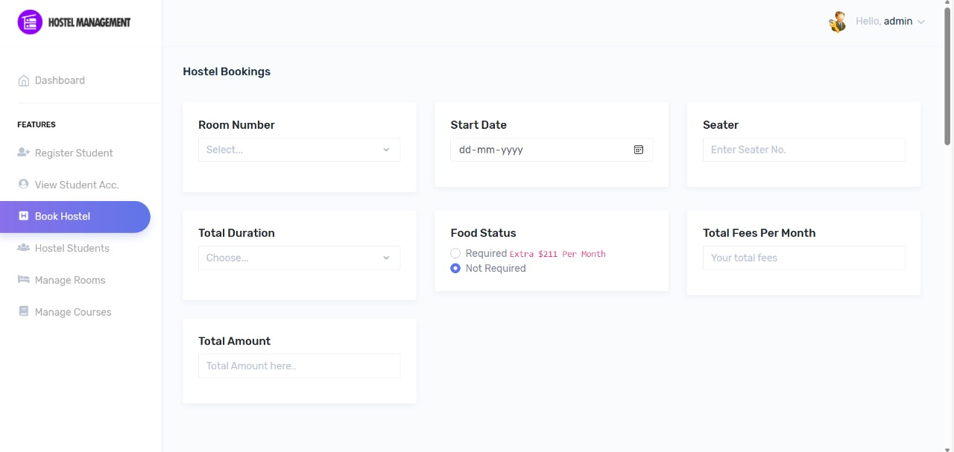
RESULTS AND DISCUSSION

Slide 20
Conclusion
The Hostel Management System successfully automates and simplifies the entire process of managing hostel activities such as student registration, room allocation, fee collection, and attendance tracking. By replacing traditional manual methods with a computerized system, it minimizes errors, saves time, and improves operational efficiency.
This system provides a user-friendly interface for administrators, wardens, and students, ensuring secure data handling and easy access to information. It enhances transparency, accuracy, and accountability in hostel operations. Overall, the Hostel Management System is a reliable, efficient, and scalable solution that contributes to the digital transformation of hostel administration and improves the overall management experience.

Slide 21
Thank You
Any queries???

